Slide 1
Robotic Navigation and Exploration
Jetbot instruction
Min-Chun Hu
CS, NTHU
anitahu@cs.nthu.edu.tw

Slide 2
Outline
1. Hardware
2. Software
3. Test

Slide 3
Hardware

Slide 4
Assemble Manual
JetBot AI Kit Assemble Manual
Please based on this manual and take slides as reference.

Slide 5
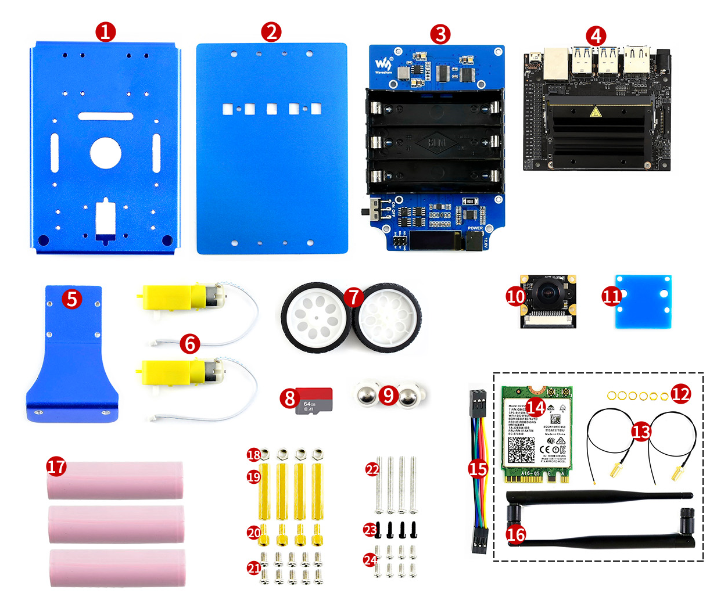
Components of Jetbot
Be carefal these two are not the same !!

Slide 6
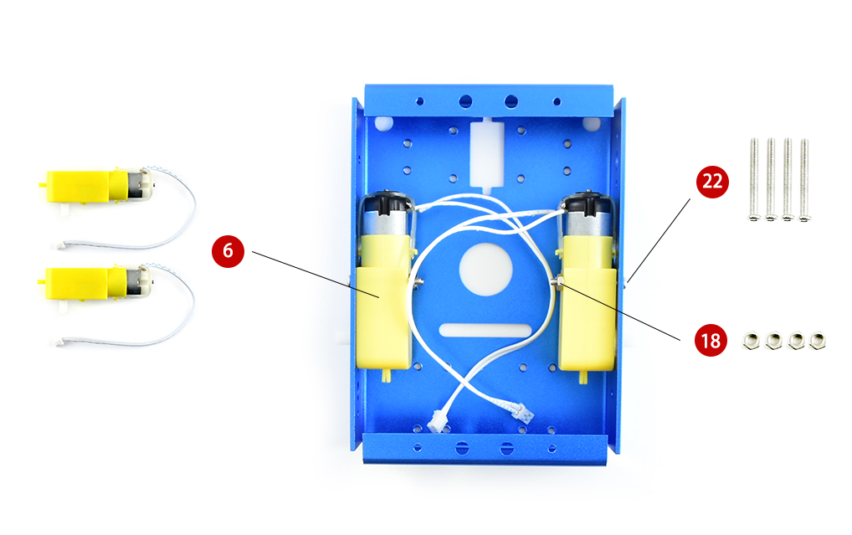
Step 1: Motor

Slide 7
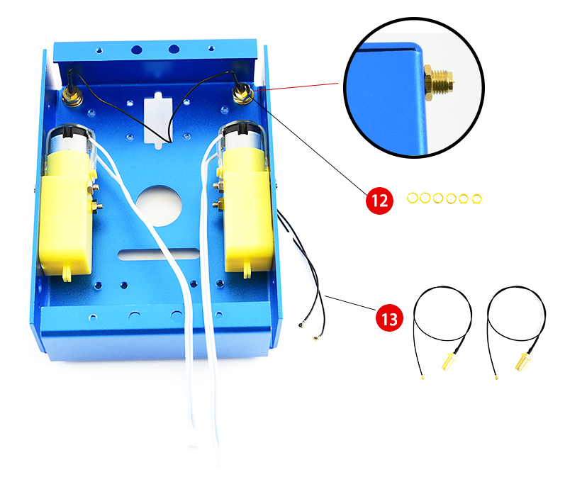
Step 2: Antenna

Slide 8
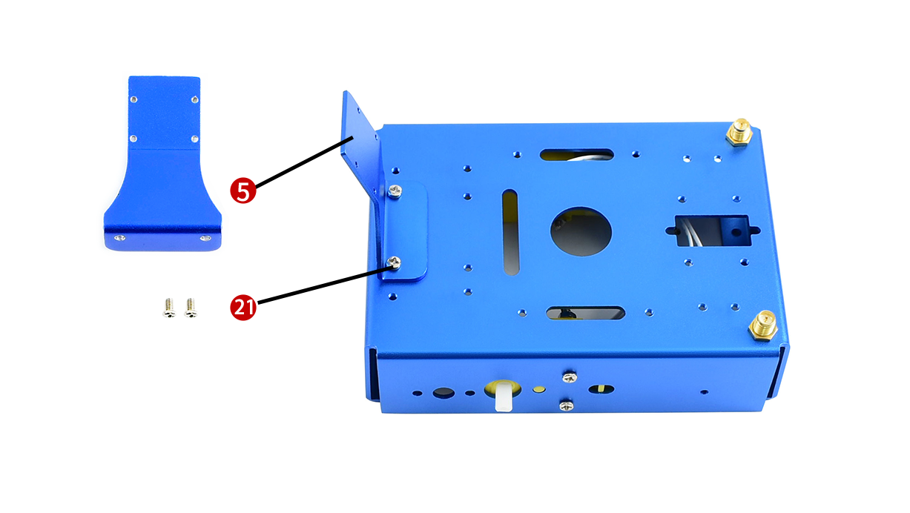
Step 3: Camera Stand
Thick screw

Slide 9
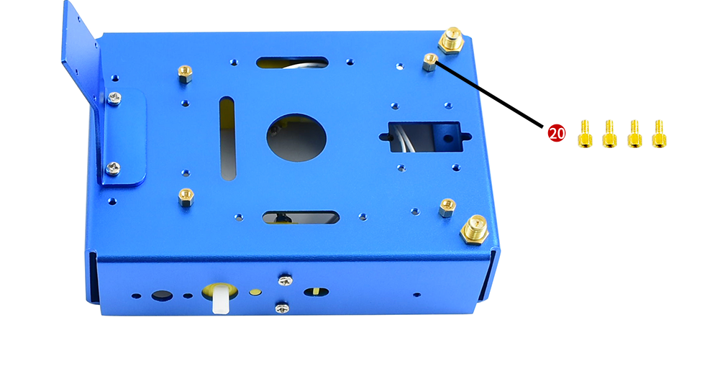
Step 4: Extend board
4. Set standoffs on metal box for assembling JetBot expansion board

Slide 10
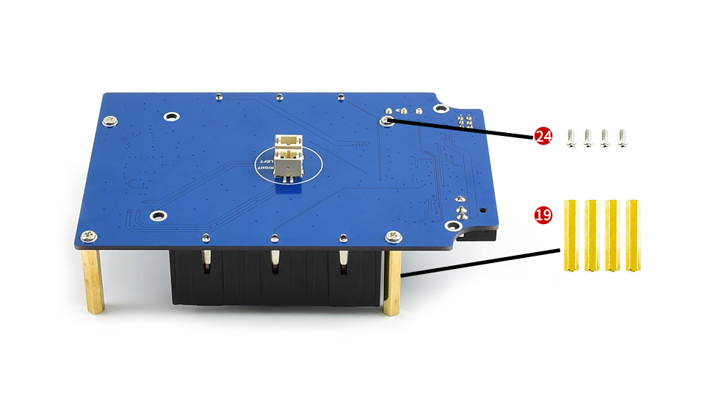
Step 5. Set standoffs on jetbot
Thin screw
5. Set standoffs on jetbot expansion board for assembling jetson nano developer kit

Slide 11
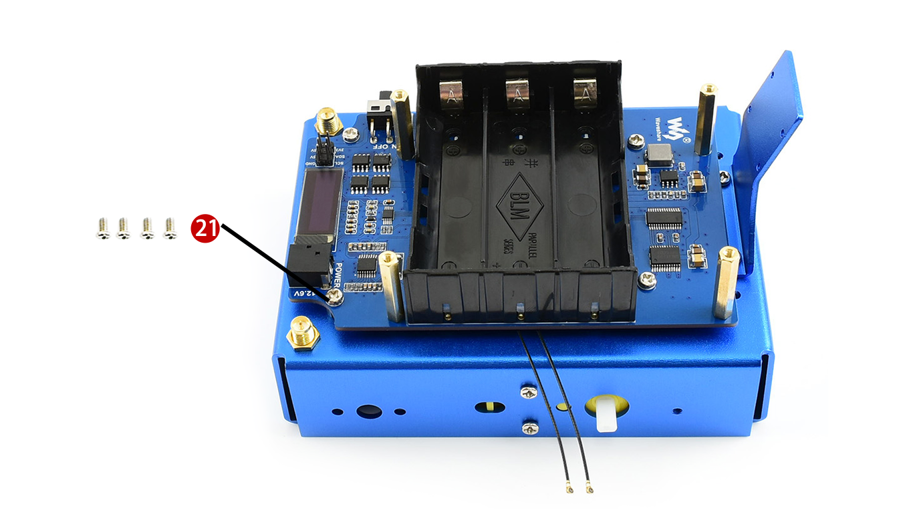
Step 6. Assemble Jetbot expansion board
Thick screw
6. Assemble Jetbot expansion board, adjust place of antennas
Antenna

Slide 12
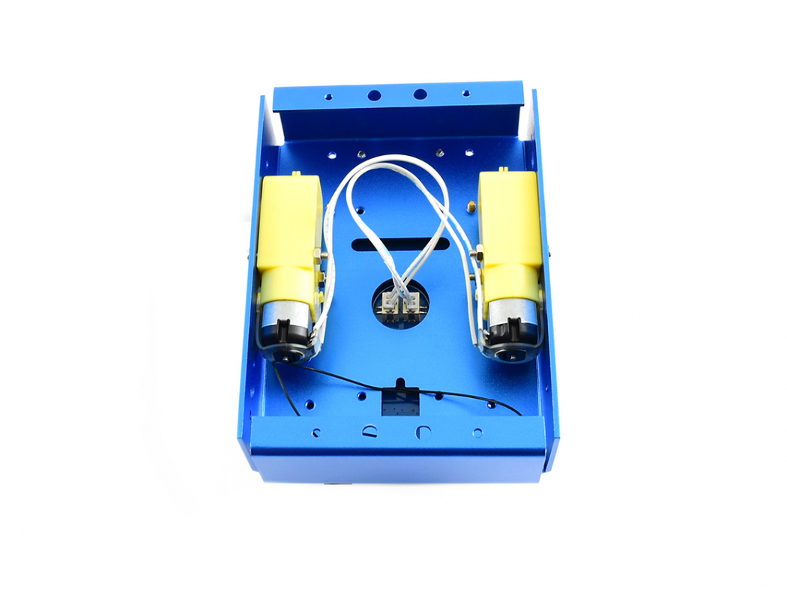
Left to Left, Right to Right
Connect motors to jetbot expansion board, connect left motor to the left interface, and right to the right

Slide 13
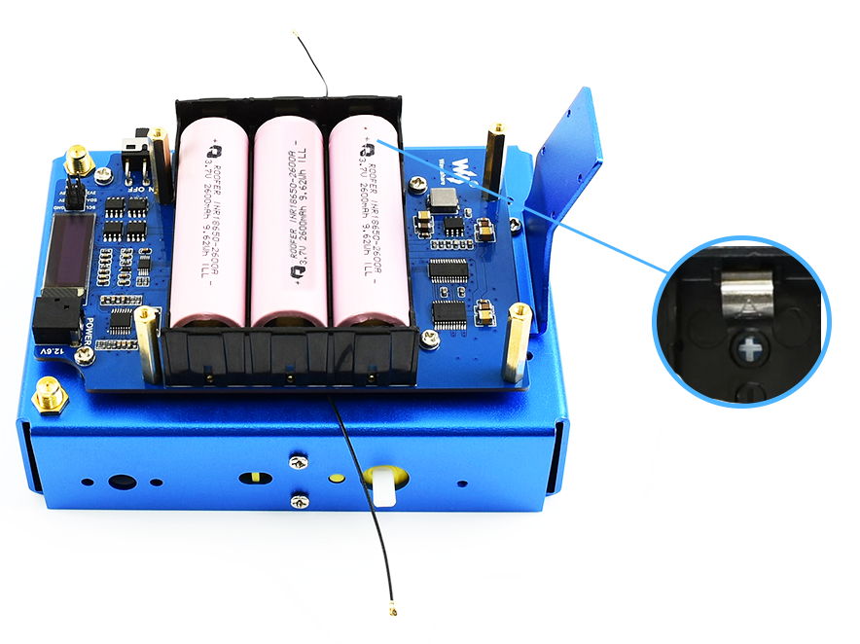
Step 7: Install battery

Slide 14
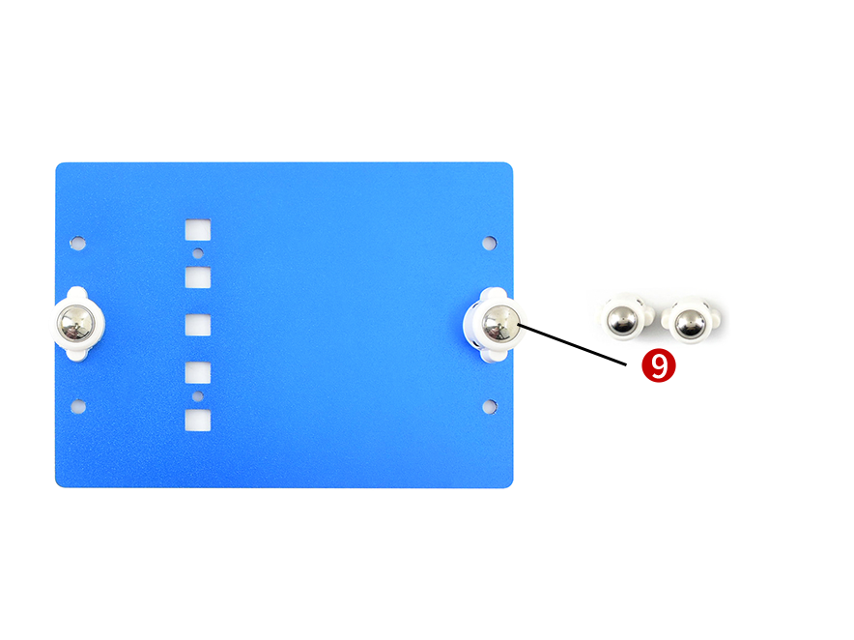
Step 8: Install universal wheel
Turn out screws from Omni-direction wheels, then fixing the wheels to metal bottom board

Slide 15
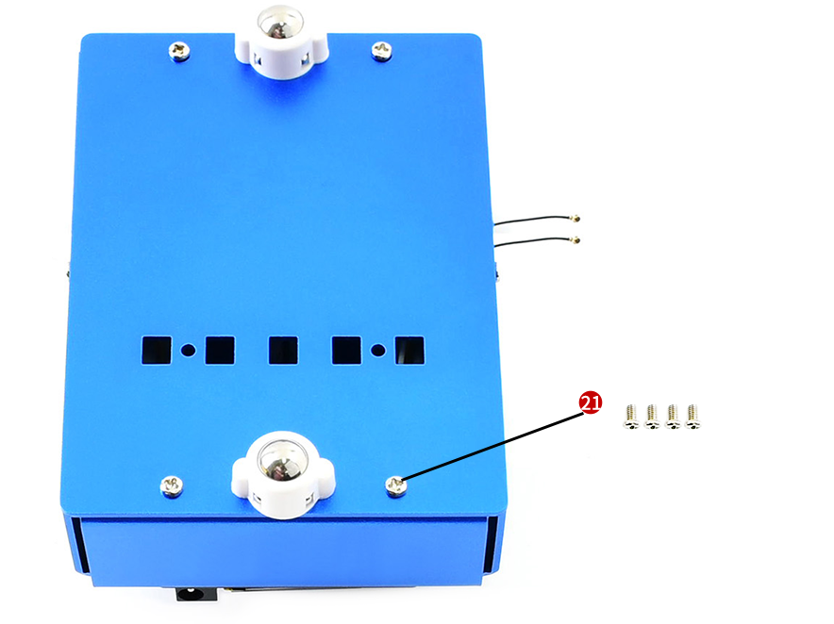
Step 9: Assemble metal box

Slide 16
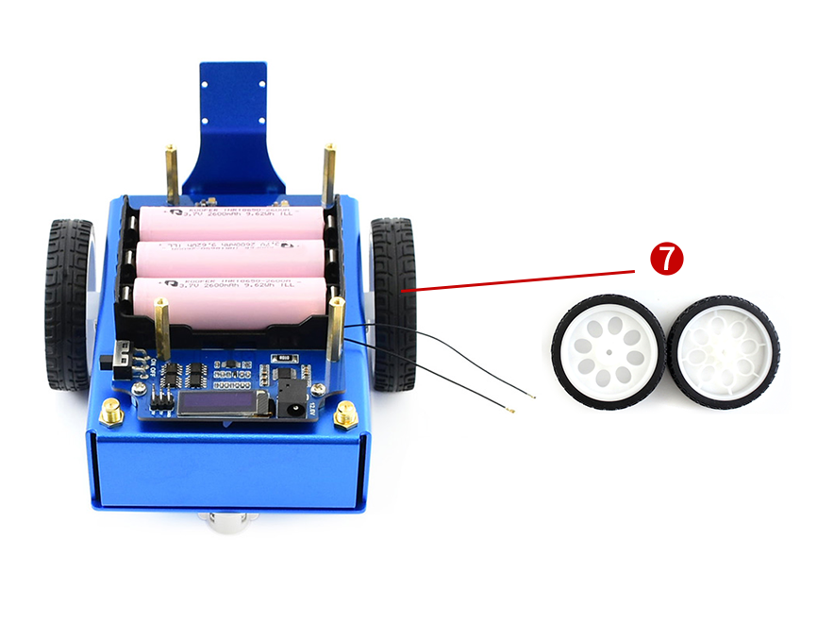
Step 10: Assemble wheels

Slide 17
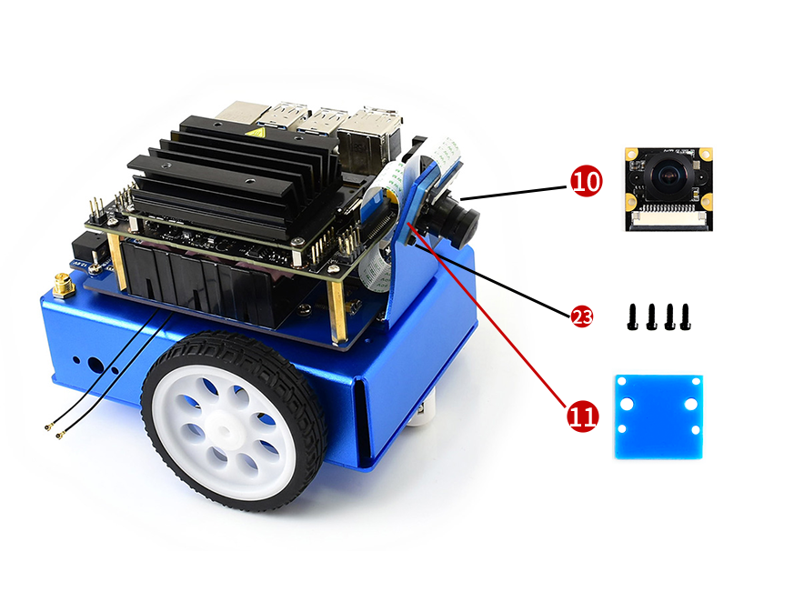
Step 11 : Install camera

Slide 18
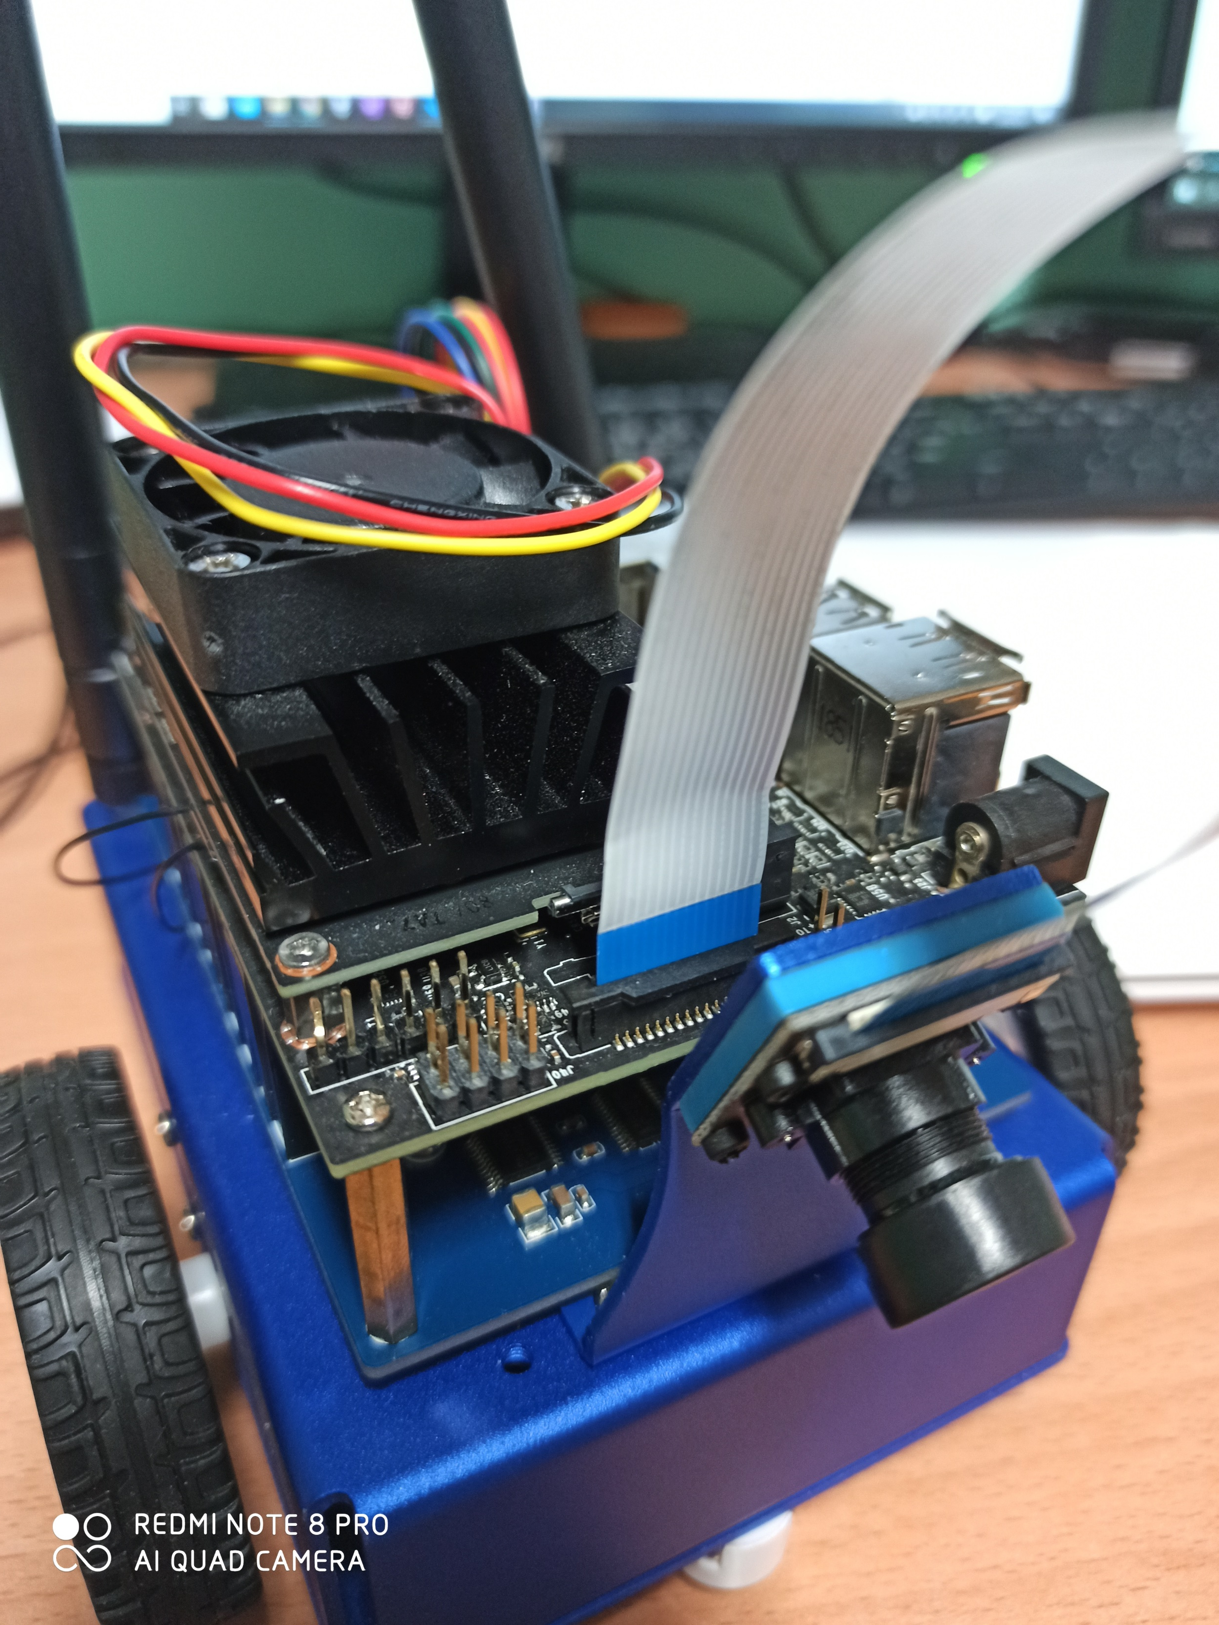
1.Pull it up
2.Tuck the Camera Cable into the slot.

Slide 19
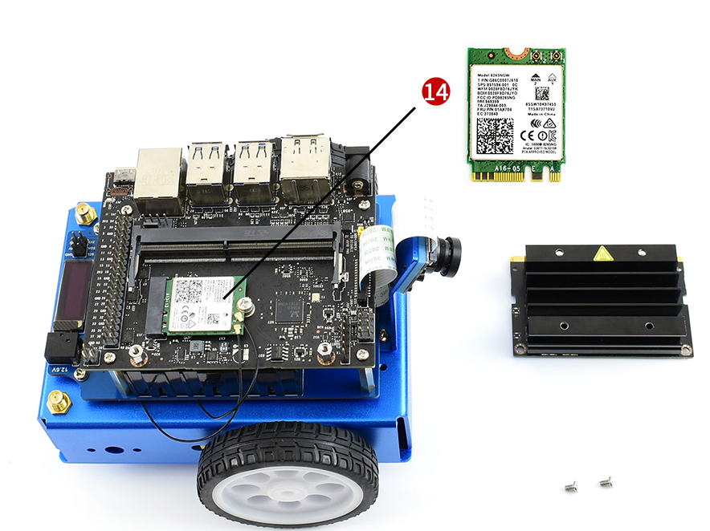
Step 11: Assemble wireless-AC 8265
Detail on next slide.

Slide 20
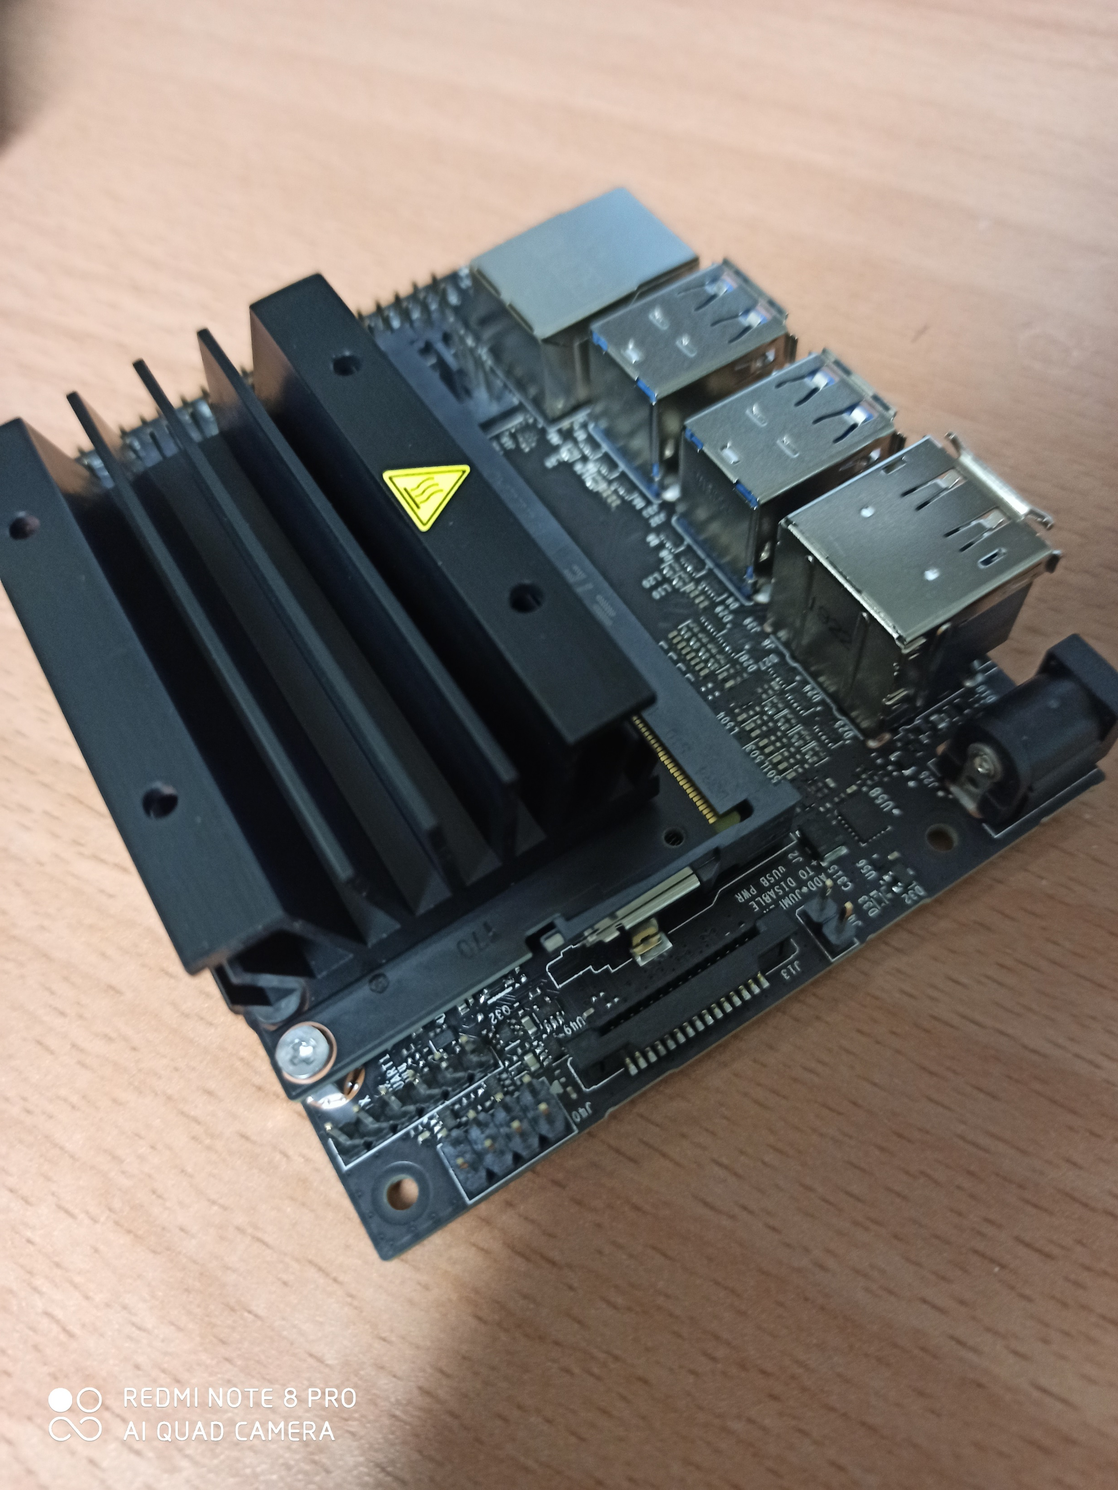
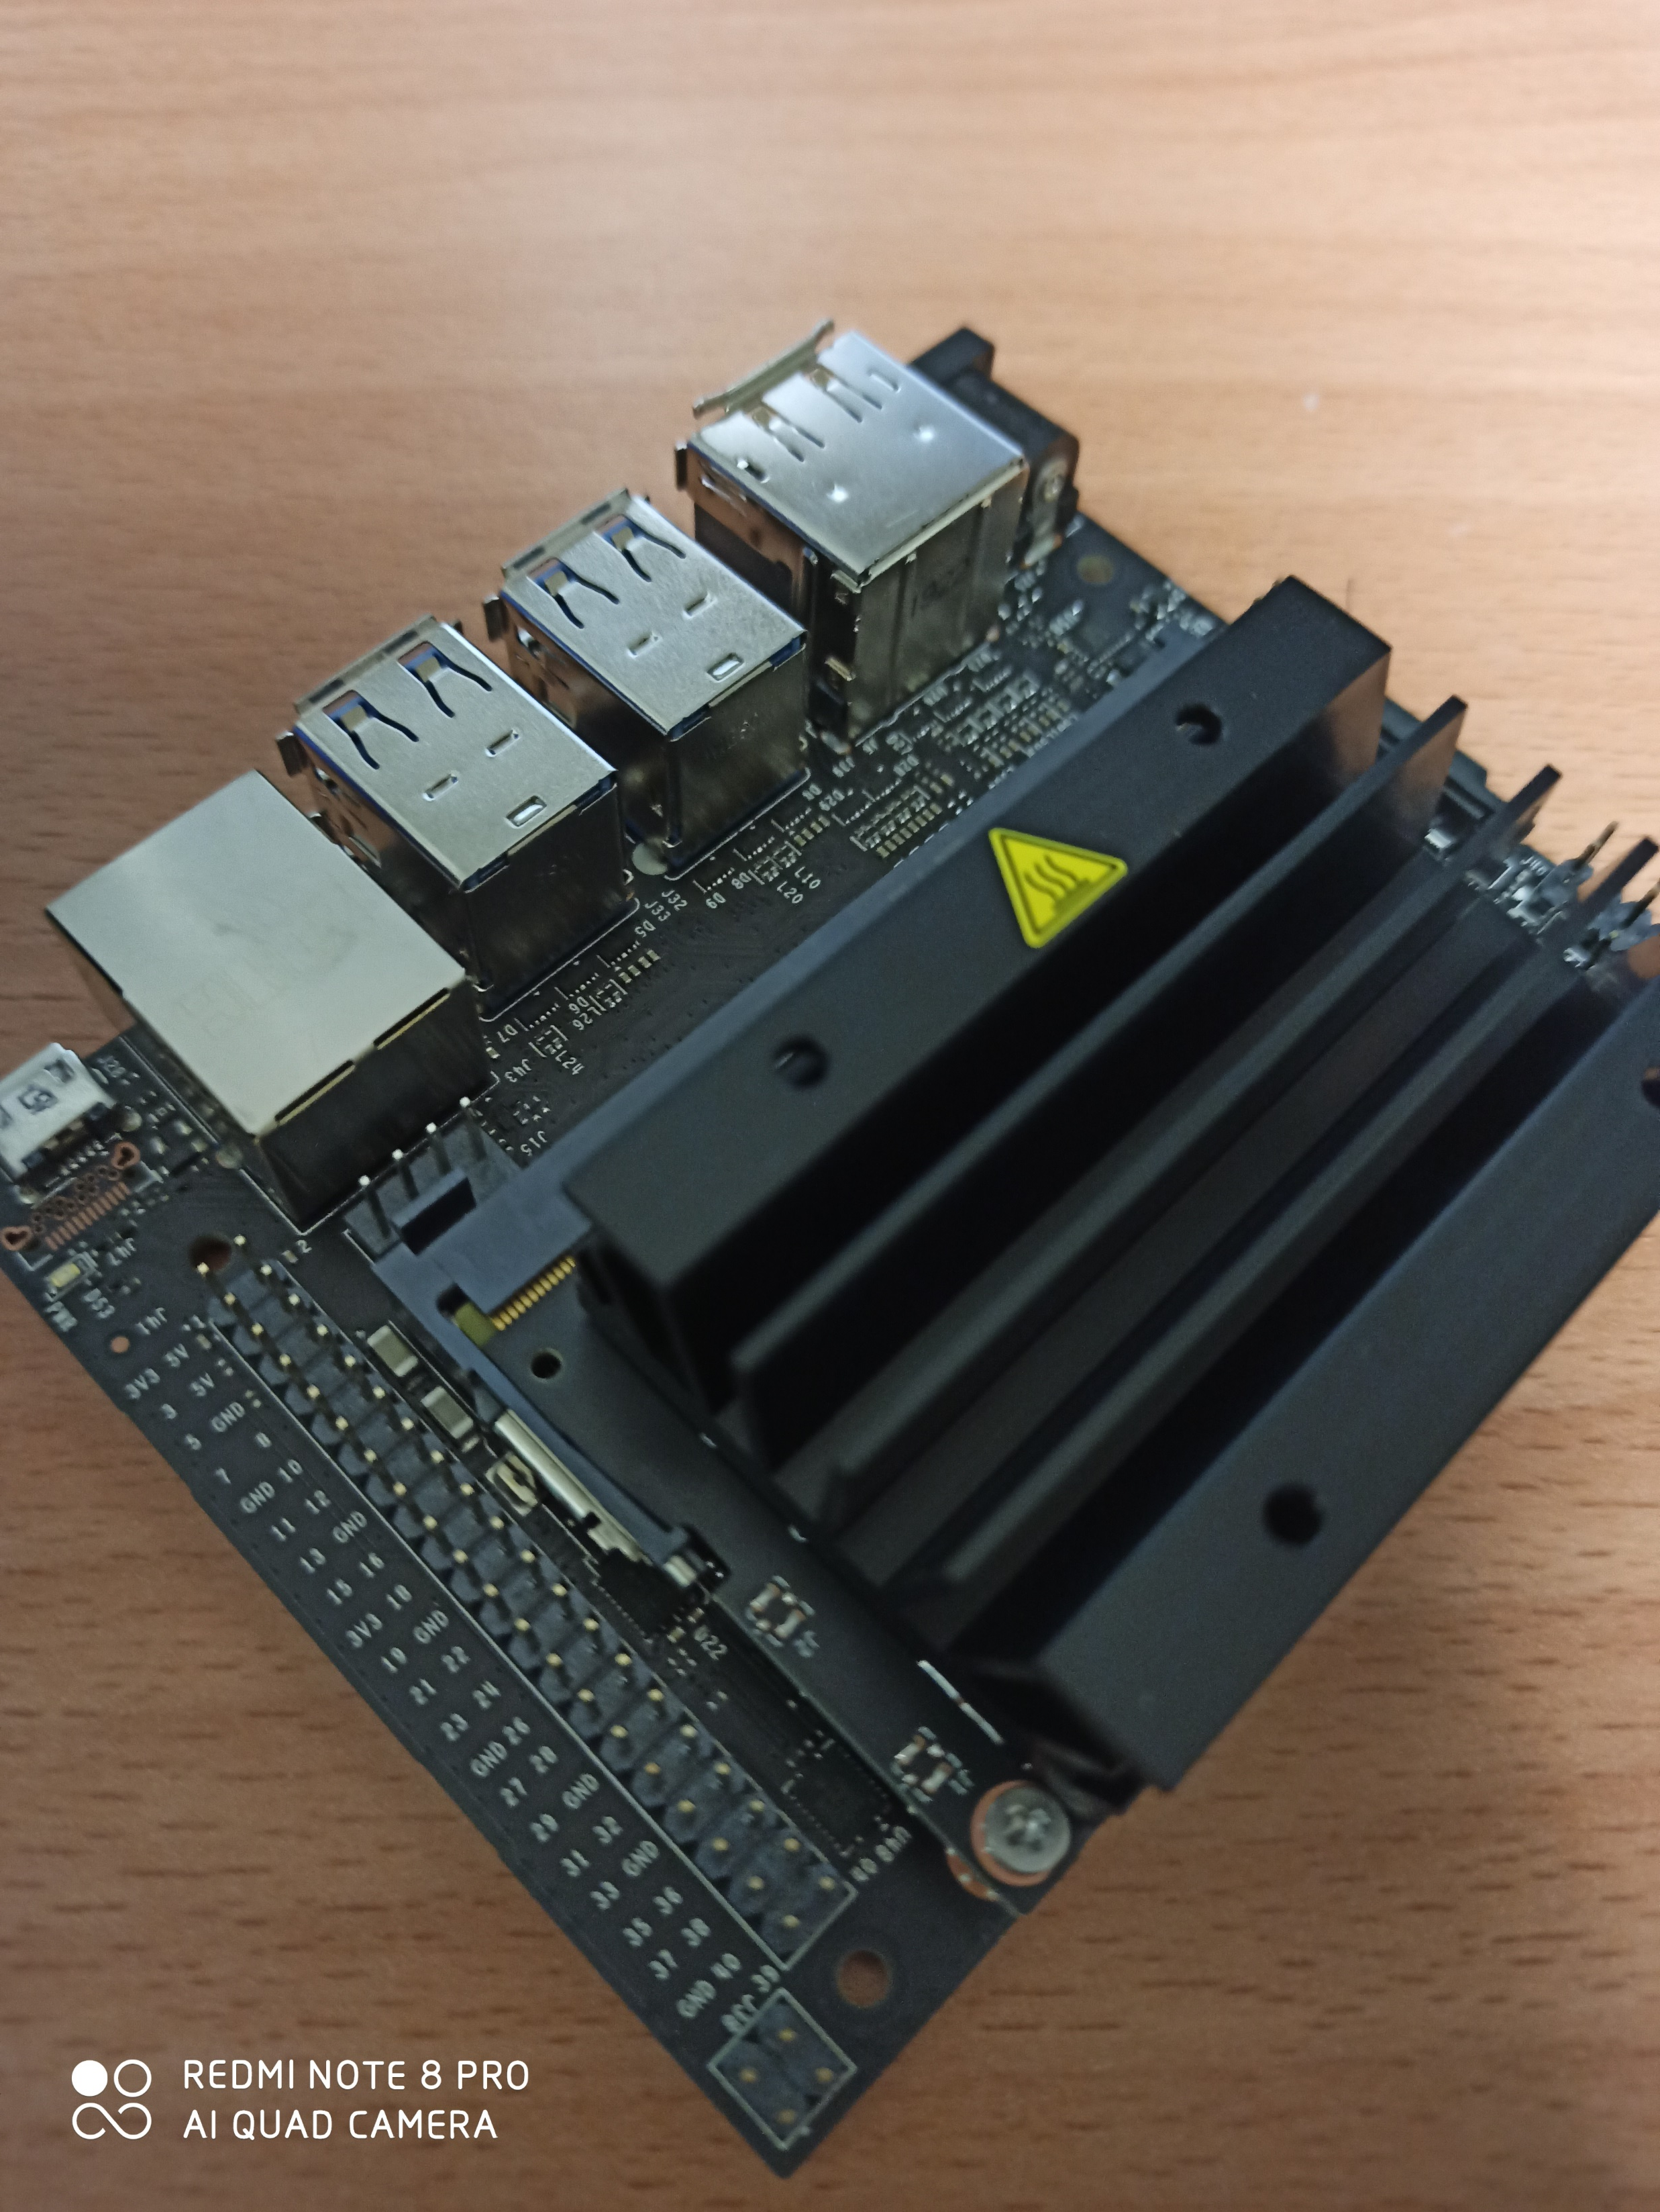
2. Hold it open
3.Pull it out
1. Turn out screws both side
3.Pull it out

Slide 21
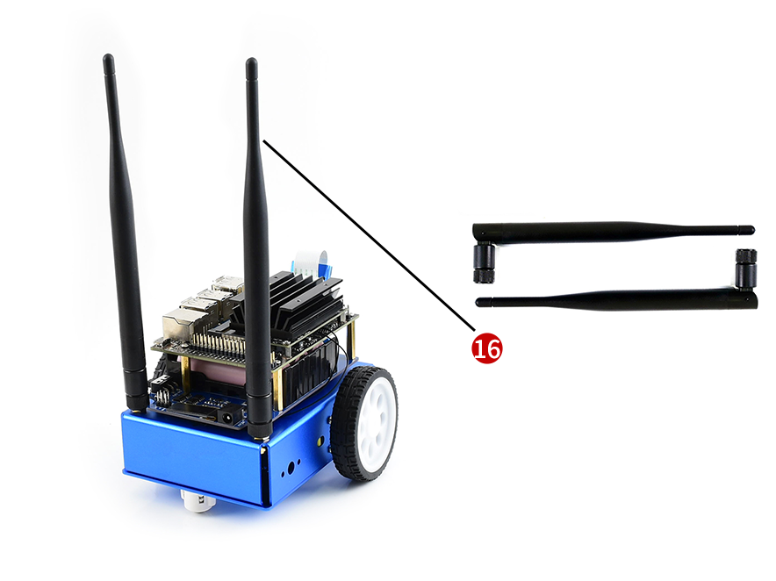
Step 13: Connect antennas

Slide 22
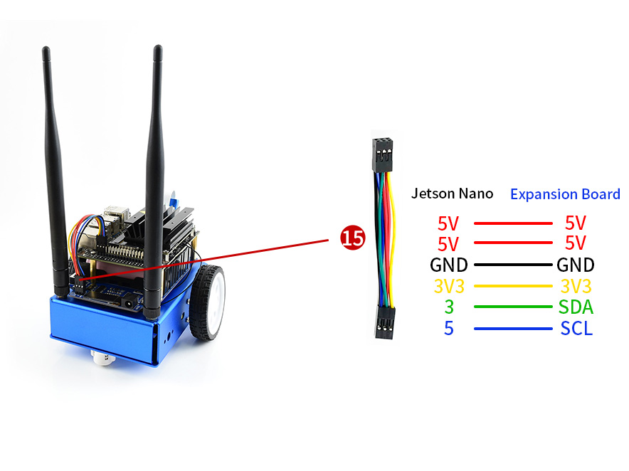
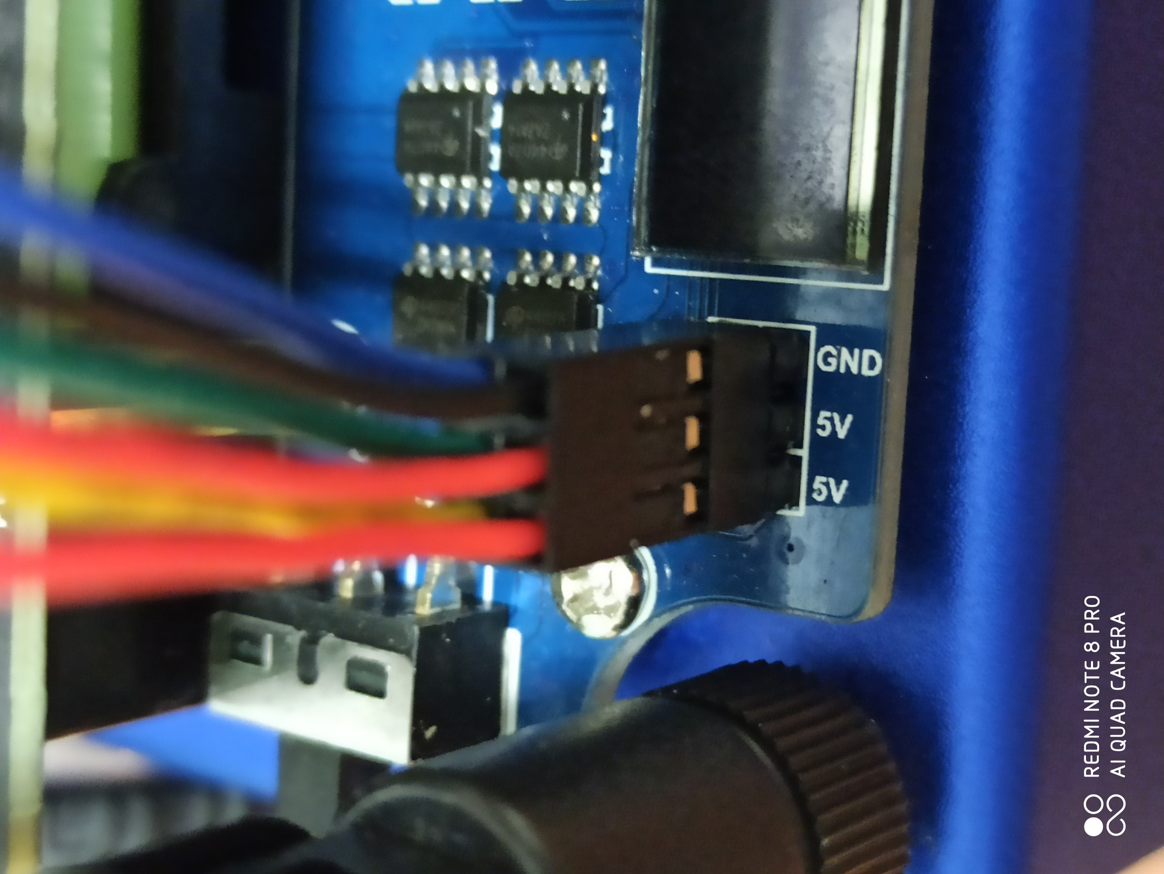
Step 14: connect the 8PIN cable
Please be careful on the order!

Slide 23
Software

Slide 24
AI Kit(OS & test reference)
JetBot AIKit
Please download OS image here.

Slide 25
Software Setup for JetBot
Step 1 - Flash JetBot image onto SD card
Download the expandable JetBot SD card image jetbot_image_v0p3p2.zip
The above expandable image should work on any SD card greater than or equal to 32GB. If you run into issues please try the archived 63GB images.
Insert an SD card into your desktop machine
Using Etcher, select the jetbot_image_v0p3p2.zip image and flash it onto the SD card
Remove the SD card from your desktop machine

Slide 26
Software Setup for JetBot
Step 2. Startup Jetson Nano Developer Kit
Connect HDMI display, keyboard and Mouse to Jetson Nano Developer Kit.

Slide 27
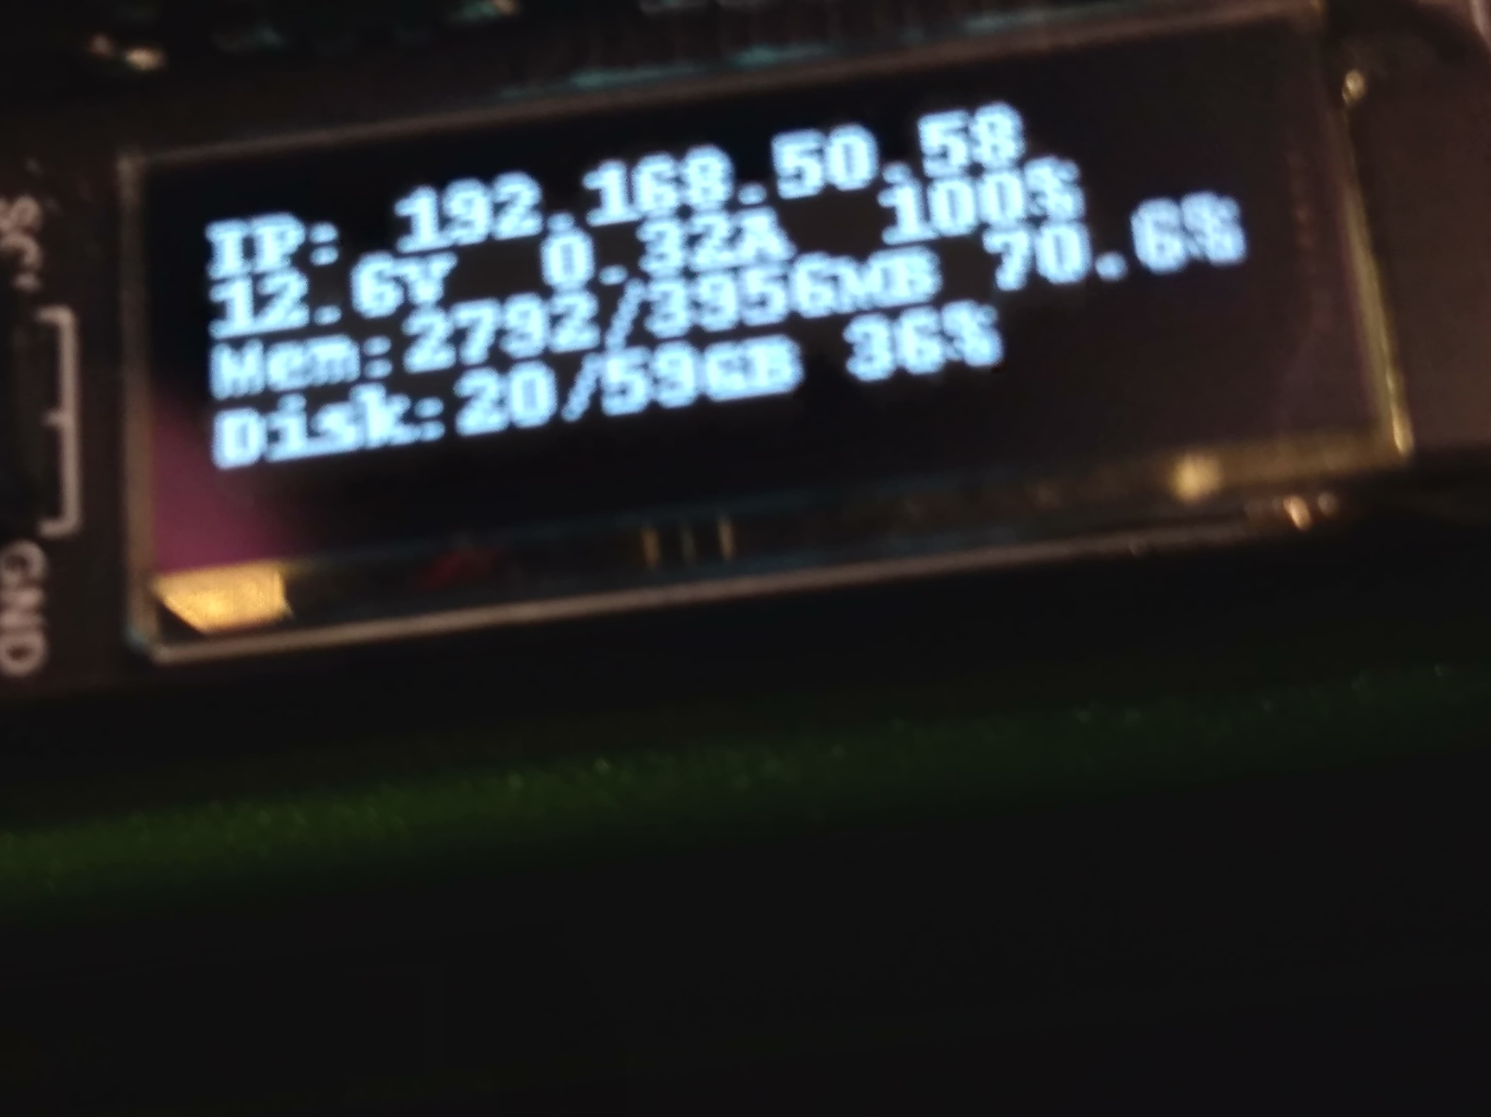
Software Setup for JetBot
Step 3. Connect Jetbot to WIFI
All the examples use WIFI, we need to connect JetBot to WIFI firstly.
Start Jetson nano Developer Kit, default user name and password of Jetbot are both jetbot
Click Network icon on top-right of Desktop and connect WIFI
Power off. Then assemble Jetbot
Start Jetson nano again. After booting, Ubuntu will auto-connect WIFI, IP address is also displayed on OLED
Jetbot screen

Slide 28
Software Setup for JetBot
Step 4. Access JetBot via Web
After networking. You can remove peripherals and power adapter.
Turn Power switch of Jetbot into On
After booting, IP address of OLED can be displayed on OLED
Navigate to http://<jetbot_ip_address>:8888 from your desktop's web browser

Slide 29
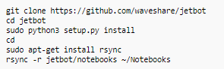
Software Setup for JetBot
Step 5. Install the latest software
The JetBot GitHub repository may contain software that is newer than that pre-installed on the SD card image. To install the latest software:
Access Jetbot by going to http://<jetbot_ip_address>:8888
Launch a new terminal. Default user name and password are both jetbot

Slide 30
Software Setup for JetBot
Step 6. Configure power mode
To ensure that the Jetson Nano doesn't draw more current than the battery pack can supply, place the Jetson Nano in 5W mode by calling the following command
ou need to launch a new Terminal and enter following commands to select 5W power mode
Check if mode is correct
sudo nvpmodel -m1
sudo nvpmodel -q

Slide 31
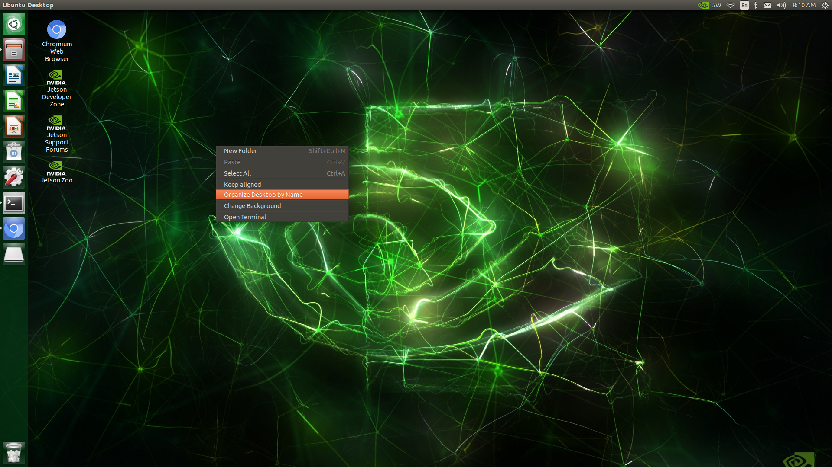
After install successfully

Slide 32
Test

Slide 33
Test for JetBot
Access jetbot by going to http://<jetbot_ip_address>:8888, navigate to ~/Notebooks/basic_motion/
Open basic_motion.ipynb file and following the notebook.

Slide 34
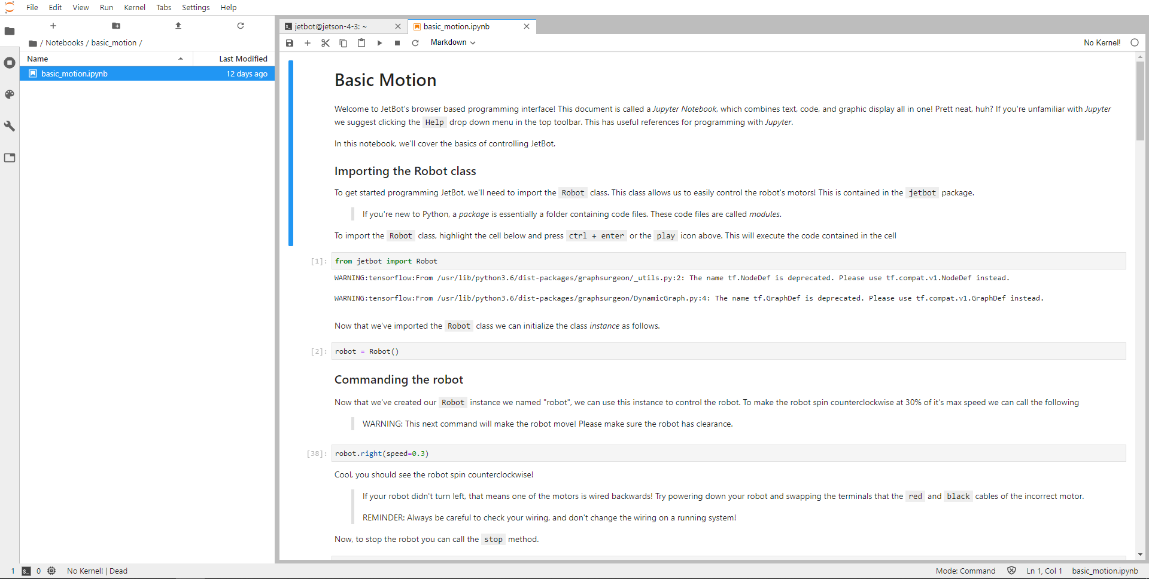
basic_motion.ipynb

Slide 35
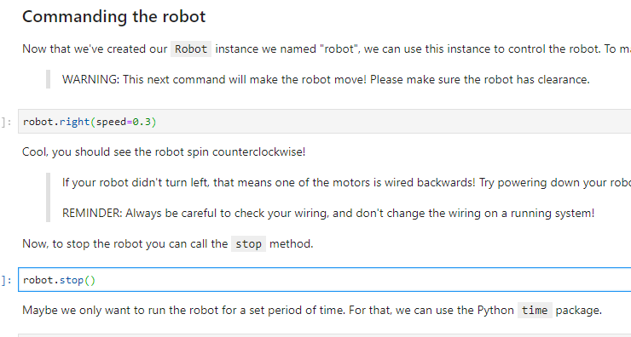
Test 1. Turn around
Example : https://drive.google.com/file/d/189kP-VIYnnSmgCOuvkb4Uz_819IIcYhx/view?fbclid=IwAR0PWQEovM53mjmX0jXtb2TQCPNH3eZpX2unAPoWy9OIZX3q4-pAmPEn94g

Slide 36
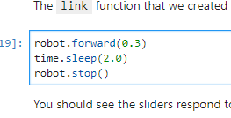
Test 2. Forward
Example : https://drive.google.com/file/d/1894LCZIn3Zgbv23l6I2ArT_hle56N81A/view?fbclid=IwAR2CUzhVOqntXG2e9ANtHkJERhfZZCZtDBYVIdcD9FvsydSgWQpUD7b0N64

